Slide 1

Week 2 – Business Analytics Fundamentals – Sydney Campus
Summary of Lecture 1
Tutorial Week 2
Key assessment dates
Attendance & Tutorial Questions - Recognising student participation and engagement specifically identifying those who are most actively involved!
Lecturer/Tutor: Dr. Farshid Keivanian

Slide 2
Open-Ended Question
How can business analytics transform the decision-making process within organizations?
Business analytics enables organizations to leverage data for informed decision-making, enhancing their ability to understand trends, predict outcomes, and optimize operations. For instance, Aussie Retailers Ltd. uses business analytics to analyze transactional data, leading to improved inventory management and customer service across their Sydney, Melbourne, and Brisbane stores. By comparing current sales data with historical data, they can identify trends and adjust inventory to meet regional demands and seasonal variations, thus maintaining a competitive edge.

Slide 3
The tutorial for Week 2 of Business Analytics Fundamentals at the Sydney Campus dives into the practical use of business analytics with an emphasis on PivotTables in Excel. Students will learn how to set up, structure, and utilize PivotTables to analyze and report on business data effectively. The course illustrates these concepts through an example involving "Aussie Retailers Ltd." and how they use transactional data for inventory management and customer service optimization. Key skills taught include data organization, aggregation, dynamic analysis, and data visualization through PivotTables. The tutorial also covers concepts such as drill-up, drill-down, drill-through, and slice and dice for multidimensional reporting.

Slide 4
1. Summary of Lecture 1
The first lecture introduces the role of business analytics in understanding and enhancing business processes through data-driven decision-making. Key topics include the characteristics of business data, the distinction between operational and management reports, and the role of information systems in managing business processes. It also highlights various data sources such as transactional data, human-generated data, and sensor data. A significant emphasis is placed on the structure and use of data in reports, explaining the importance of measures, benchmarks, and key performance indicators (KPIs) for assessing business performance.

Slide 5
1. Summary of Lecture 1: A Practical Example in Australia
An Australian retail company, "Aussie Retailers Ltd.," utilizes business analytics to optimize its inventory management and customer service. By analyzing transactional data from sales across their stores in Sydney, Melbourne, and Brisbane, they generate management reports that help them understand purchasing trends and customer preferences. These reports compare current sales data to historical data to identify trends, allowing them to tailor their inventory to regional preferences and seasonal demand. Additionally, by leveraging operational reports on daily sales and inventory levels, store managers can make real-time decisions to reorder stock or launch promotions to maximize revenue. The data-driven approach helps Aussie Retailers maintain a competitive edge by ensuring they meet customer needs effectively while managing their supply chain efficiently.
This example illustrates how business analytics can be practically applied to improve business processes and decision-making within an Australian context.

Slide 6
Open-Ended Question
Why is understanding the different types of business data critical for effective analytics?
Understanding different types of business data, such as transactional, human-generated, and sensor data, is crucial for selecting appropriate analytical methods and tools. For example, in a Melbourne-based logistics company, transactional data helps track deliveries, human-generated data provides customer feedback, and sensor data monitors vehicle locations and conditions.

Slide 7
Example
A Melbourne logistics company uses sensor data to optimize delivery routes and ensure timely deliveries, enhancing customer satisfaction and operational efficiency.

Slide 8
Open-Ended Question
How do PivotTables facilitate dynamic analysis and reporting in business analytics?
PivotTables allow users to summarize and analyze large datasets dynamically, enabling quick insights without altering the original data. They support various aggregation functions and visualizations, making it easier to identify patterns and trends.

Slide 9
Example
A retail manager in Sydney uses PivotTables to analyze monthly sales data, identify top-performing products, and adjust stock levels accordingly to meet customer demand.

Slide 10
Open-Ended Question
Why is data visualization important in communicating business insights?
Data visualization translates complex data into understandable visuals, helping stakeholders grasp key insights quickly and make informed decisions. Effective visualizations can highlight trends, outliers, and correlations that might not be evident in raw data.

Slide 11
Example
A business analyst in Brisbane creates interactive dashboards using tools like Tableau to present sales performance to executives, aiding in strategic planning and market analysis.

Slide 12
2. Tutorial Week 2: Concepts
PivotTables: PivotTables are a powerful feature in spreadsheet software like Microsoft Excel or Google Sheets that allow users to summarize and analyze large datasets quickly and efficiently. They work by reorganizing and summarizing selected columns and rows of data into a more digestible format without altering the original dataset. Microsoft Excel requires us to convert the data to table format before we can apply the PivotTable features. In Table format we can perform some simple formatting, such as Filtering to improve the report.
Here's how PivotTables work:
Data Organization: PivotTables allow users to organize and summarize data based on different criteria such as categories, dates, numerical values, etc. Users can choose which columns and rows of data to include in the PivotTable and how they want to arrange and summarize that data.
Aggregation: PivotTables provide various options for aggregating data, including sum, count, average, minimum, maximum, etc. Users can choose the appropriate aggregation function based on the type of data being analyzed.

Slide 13
2. Tutorial Week 2: Concepts
Dynamic Analysis: One of the key advantages of PivotTables is their dynamic nature. Users can easily rearrange the layout of the PivotTable, change the criteria for summarization, and apply filters to focus on specific subsets of data. This flexibility allows for interactive and exploratory data analysis.
Summarization: PivotTables automatically group and summarize data based on the criteria chosen by the user. For example, if you have a dataset with sales data by region, product, and date, you can use a PivotTable to quickly summarize total sales by region and product, or analyze sales trends over time.
Visualization: PivotTables can also be used to create visualizations such as charts and graphs to further explore and communicate insights from the data. These visualizations can help users identify patterns, trends, and outliers more easily.

Slide 14
2. Tutorial Week 2: Concepts
PivotTables are incredibly useful for summarizing large datasets because they allow users to:
Quickly summarize and analyze large volumes of data without the need for complex formulas or manual calculations.
Easily rearrange and explore different views of the data to gain insights from different perspectives.
Create dynamic reports and dashboards that can be updated easily as new data becomes available.
Preserve the integrity of the original dataset since PivotTables do not alter the underlying data—they simply provide a summary and analysis of it.
Overall, PivotTables are a powerful tool for data analysis and reporting, enabling users to extract meaningful insights from large datasets in a flexible and efficient manner.

Slide 15
2. Tutorial Week 2: Exercises
Setting Up a PivotTable
Open Excel Workbook: Start with the provided 'PivotTable.xlsx' file. Ensure you understand the layout and data.
Convert Data to Table:
Select any cell within the data range and navigate to Insert > Table.
Ensure the 'My table has headers' option is checked in the dialog box that appears, then click OK.
3. Inserting a PivotTable:
Navigate to Insert > PivotTable.
Choose the table or range as the data you just formatted as a table.
Decide whether to place the PivotTable in a new worksheet or an existing one, then click OK.

Slide 16
2. Tutorial Week 2: Exercises
Configuring the PivotTable Field List Setup:
1. Open your Excel Workbook.
Navigate to the worksheet containing your data or where you plan to insert the PivotTable.
2. Insert a PivotTable:
Select your data range.
Go to the Insert tab and click on PivotTable.
Choose where you want the PivotTable to be placed (new worksheet or existing worksheet).
3. Setup the PivotTable Field List:
Once the PivotTable is created, the PivotTable Field List pane will appear on the right side of your Excel window.
You can drag and drop fields into four different areas: Filters, Columns, Rows, and Values.

Slide 17
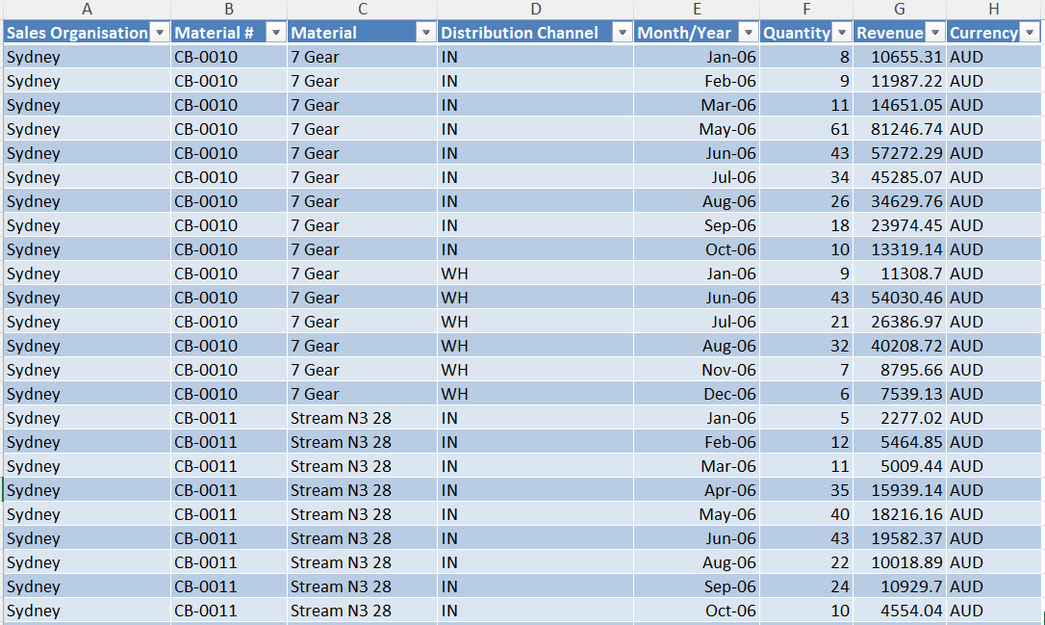
2. Tutorial Week 2: Exercises

Slide 18
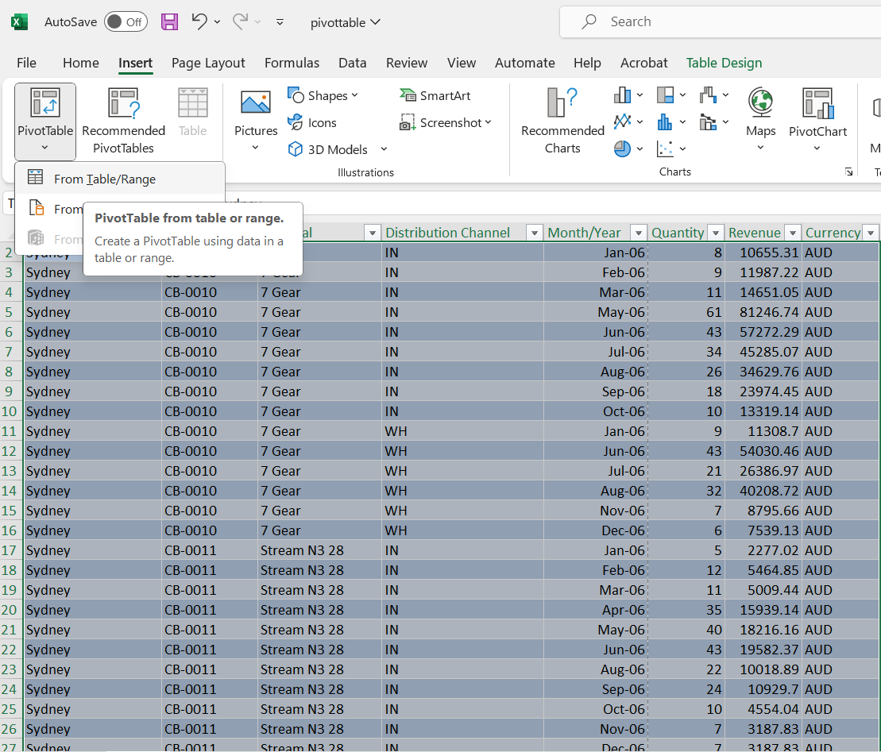
2. Tutorial Week 2: Exercises

Slide 19
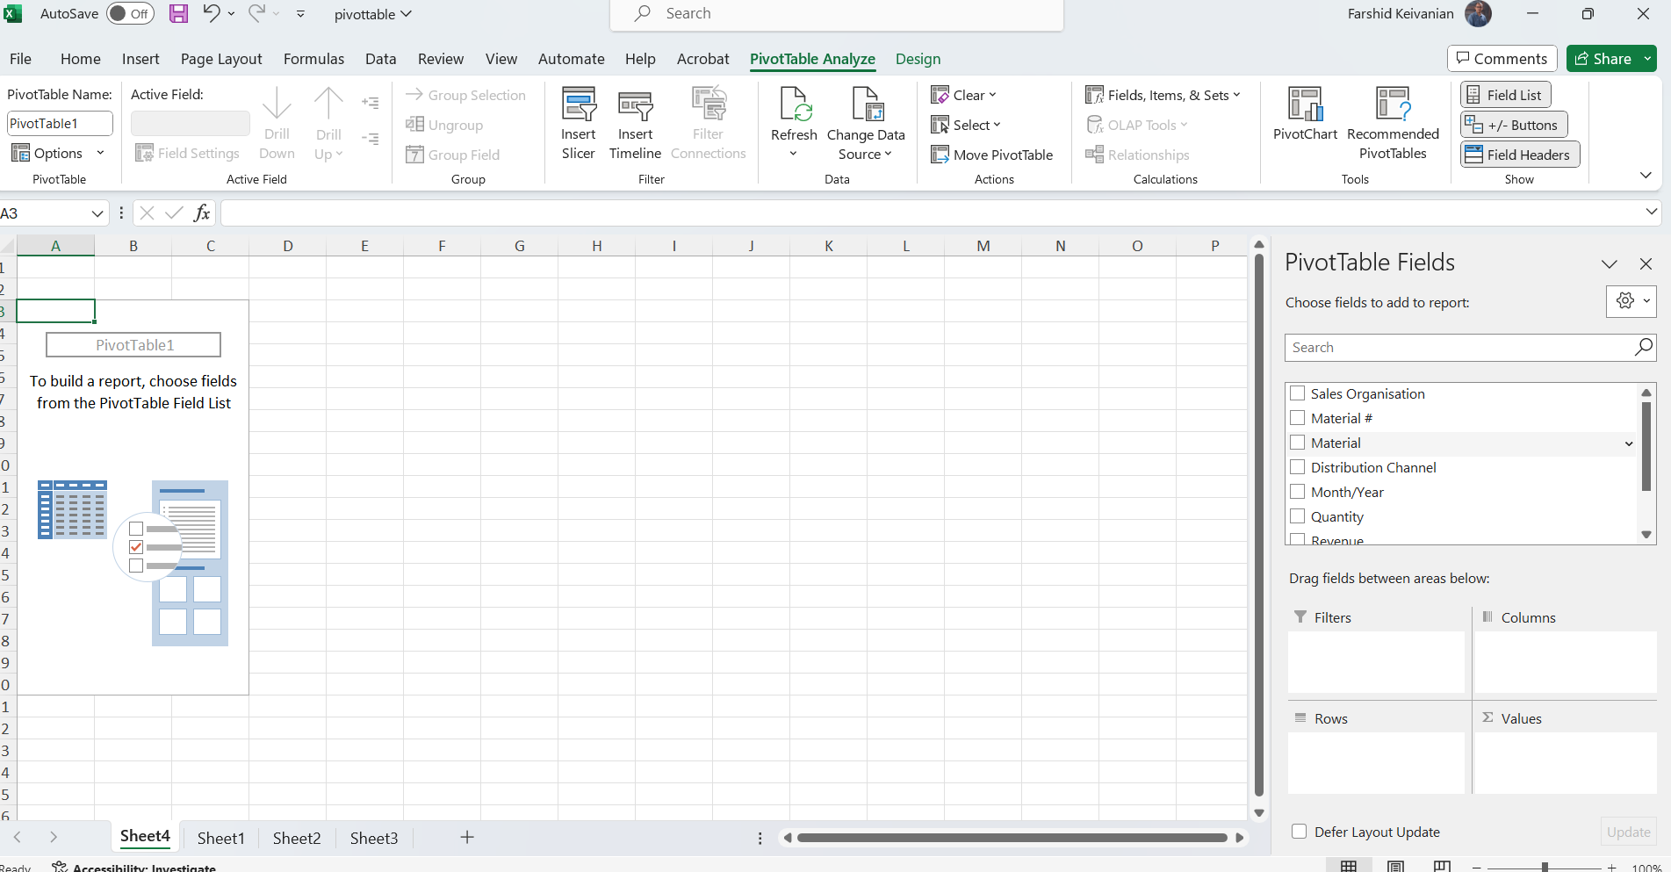
2. Tutorial Week 2: Exercises
You will see your column headers or field names listed in this pane.
You can drag and drop these fields into four different areas at the bottom of the PivotTable Field List pane:
Filters: Add fields here if you want to filter the entire table based on a category.
Columns: Add fields here that you want to display as columns in your PivotTable.
Rows: Add fields here that you want to display as rows in your PivotTable.
Values: Add fields here that you want to summarize, such as calculating the sum, average, count, etc.

Slide 20
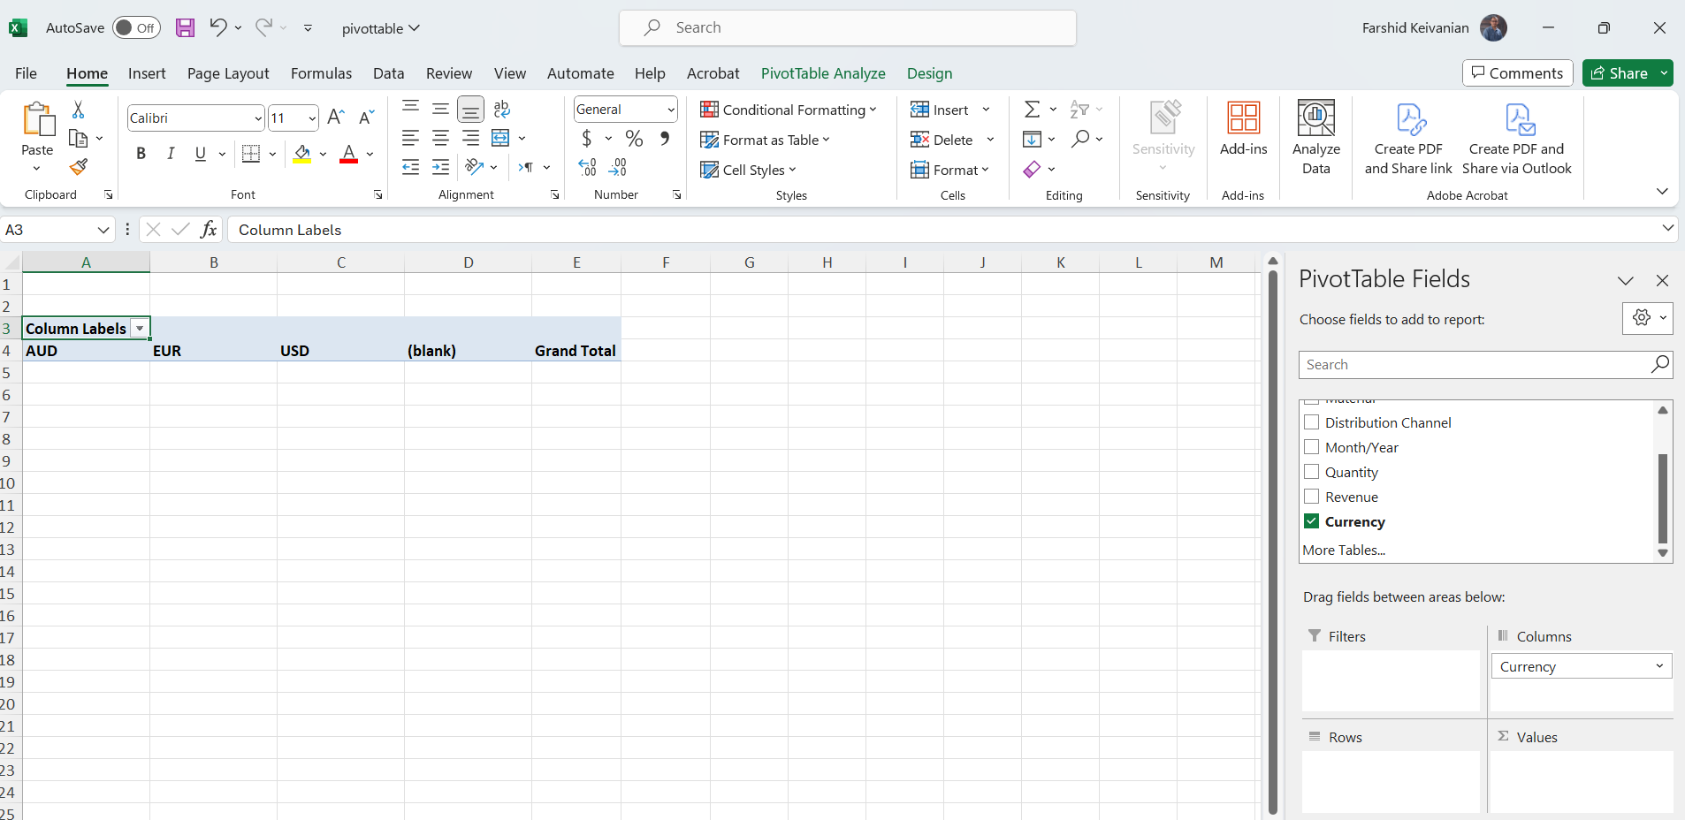
2. Tutorial Week 2: Exercises

Slide 21
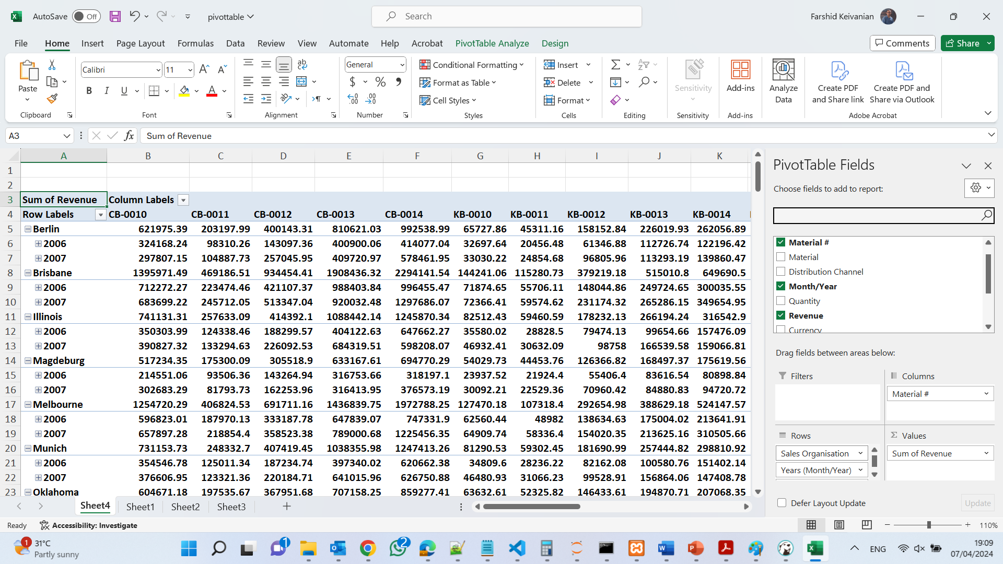
2. Tutorial Week 2: Exercises
For example, if you want to analyze revenue by sales organization and material number, you would drag the "Sales Organisation" field to Rows, the "Material #" field to Columns, and the "Revenue" field to Values. If you also want to analyze by month, you would drag "Month/Year" to either Rows or Columns, depending on how you want to view the data.
The fields you choose for Rows and Columns will define the structure of your PivotTable, and the fields in the Values area will be calculated for each row and column intersection. The Filters area allows you to limit what data is shown in the PivotTable based on the filter fields.

Slide 22
Sales Organisation and Material Numbers: The PivotTable is structured with 'Sales Organisation' in the rows and 'Material #' in the columns. This allows you to see the revenue generated by each material number for each sales organization.

Slide 23
Revenue Data: The values in the PivotTable represent the sum of revenue for the intersection of each sales organization and material number. These are provided for two years as seen in the row labels (2006 and 2007).

Slide 24
Yearly and Total Revenue: For each sales organization, there are subtotals for each year (2006 and 2007), providing an insight into the annual revenue changes for each material. At the end of each sales organization's section, there is a total revenue figure, which gives the combined revenue for all materials for that particular sales organization across both years.

Slide 25
Material Performance: We can compare how different materials performed within a single sales organization as well as across different sales organizations. For instance, we can identify which material numbers are bestsellers and which are not performing as well.

Slide 26
Comparing Sales Organizations: It's possible to compare the performance of sales organizations against each other. This can highlight which locations are generating the most revenue and which may need attention or strategy changes.

Slide 27
Trends Over Time: By including both 2006 and 2007, you can identify trends over time. For example, whether revenue is increasing or decreasing for specific materials or within certain sales organizations.

Slide 28
From the PivotTable, if we see a significant increase or decrease in revenue from 2006 to 2007 for a specific material or sales organization, this could warrant further investigation to understand the underlying causes.
Lastly, the overall layout of the PivotTable allows for a comprehensive overview, making it easier for stakeholders to make informed decisions based on the presented data.

Slide 29
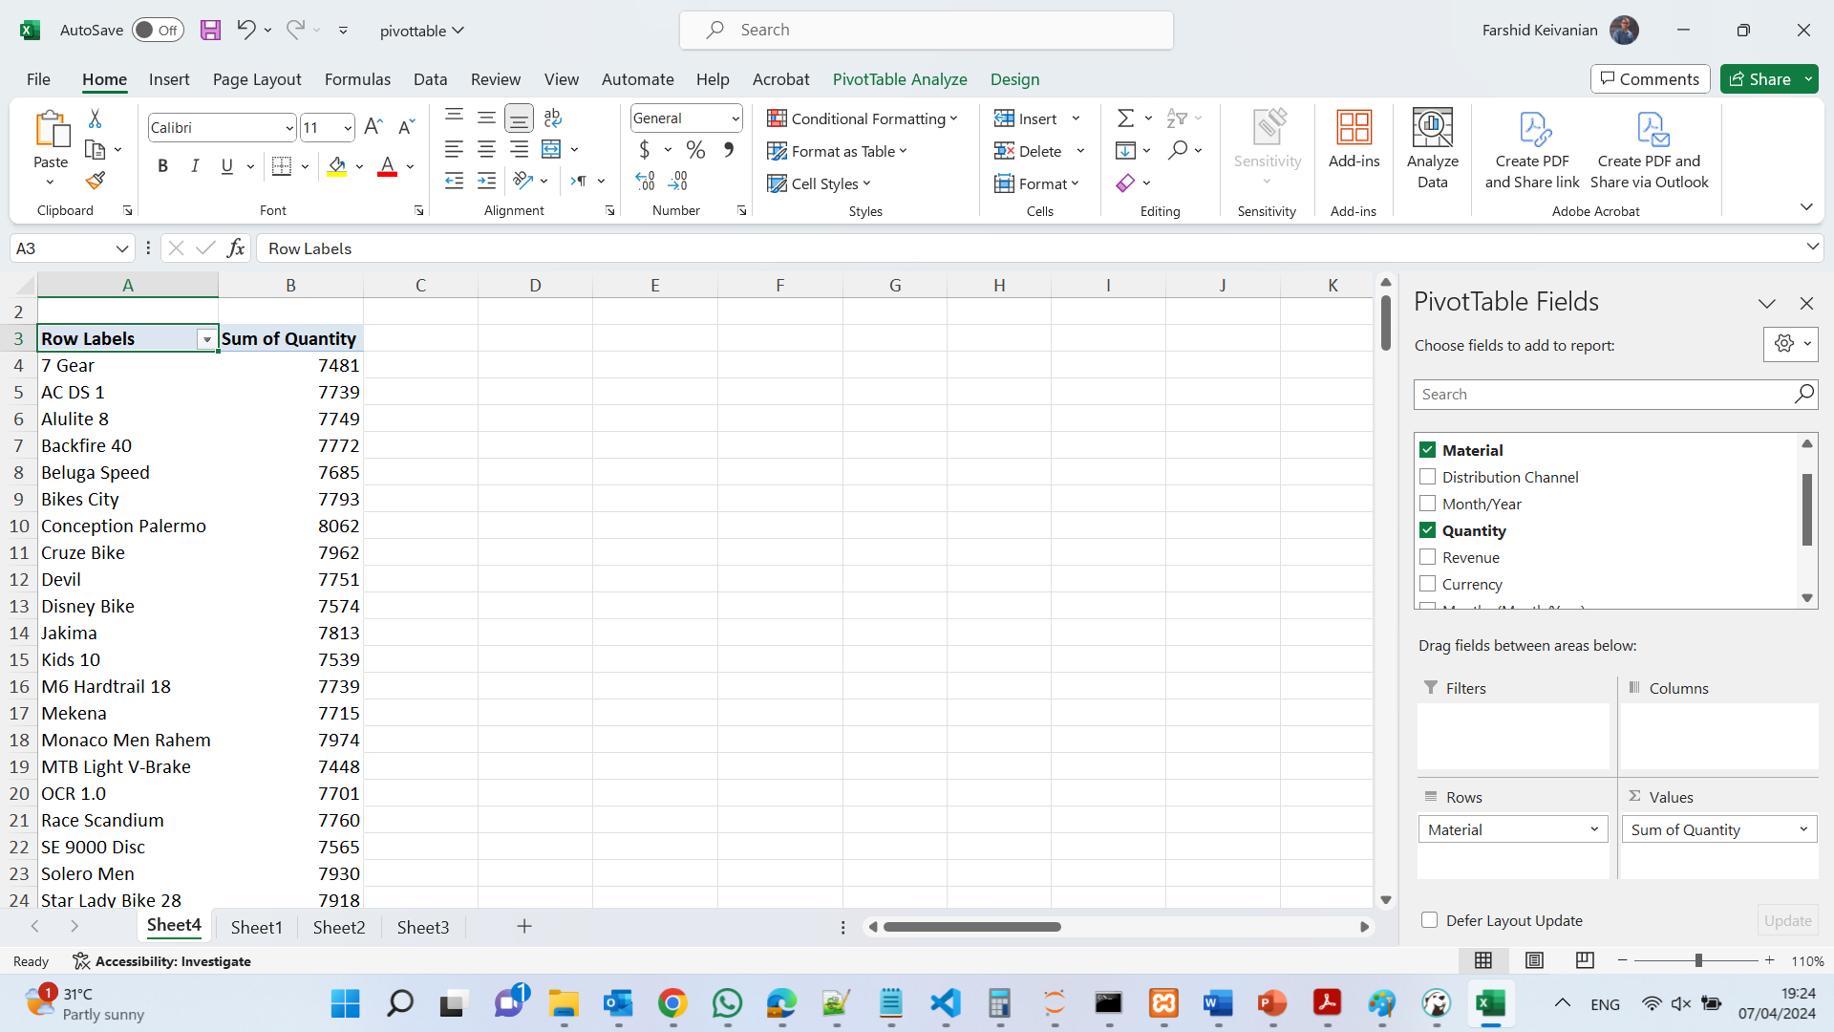
2. Tutorial Week 2: Exercises
Configuring the PivotTable Field List Setup:
4. Example Configuration:
To find out which material sold the most, drag the Material field to the Rows area.
Drag the Quantity field to the Values area and ensure it is set to sum (it usually defaults to this, but if not, click on the small drop-down arrow next to Quantity in the Values area and select Summarize Values By > Sum).

Slide 30
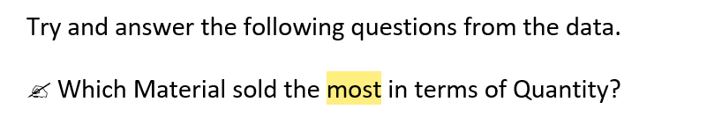

Slide 31
2. Tutorial Week 2: Exercises
Sorting and Filtering:
Applying Filters:
While the PivotTable cell is selected, go to the Data tab on the Excel ribbon.
Look for the Sort & Filter group in the ribbon.
Click on Sort Largest to Smallest. This will reorder your PivotTable data to show the items with the highest quantities at the top.

Slide 32
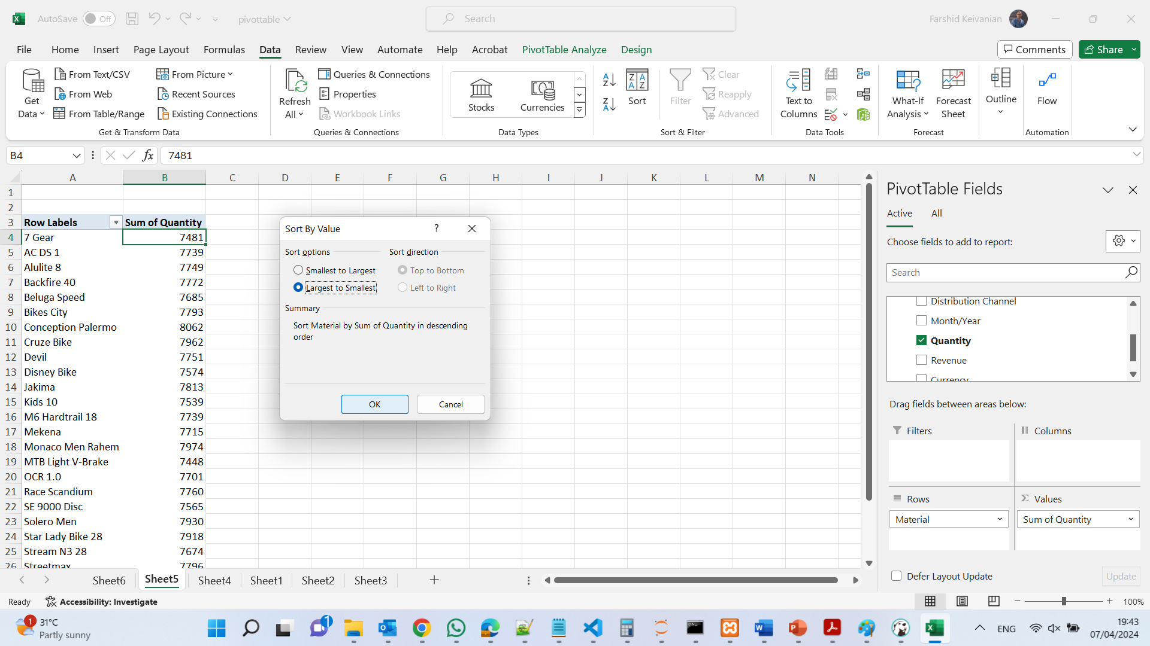

Slide 33
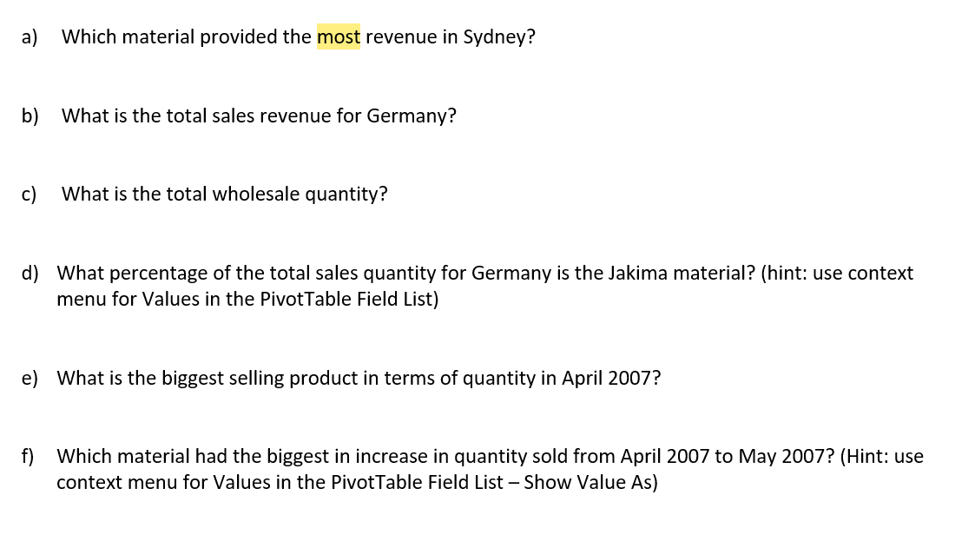
2. Tutorial Week 2: Exercises

Slide 34
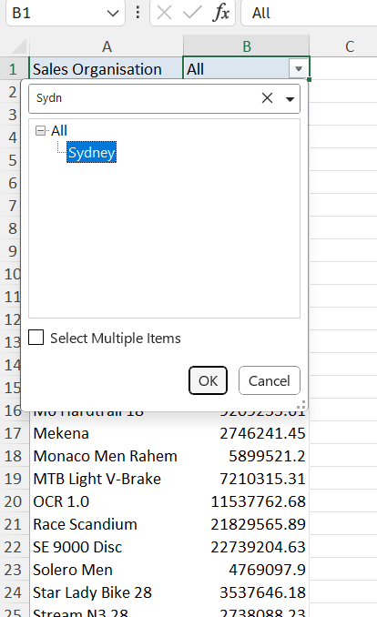
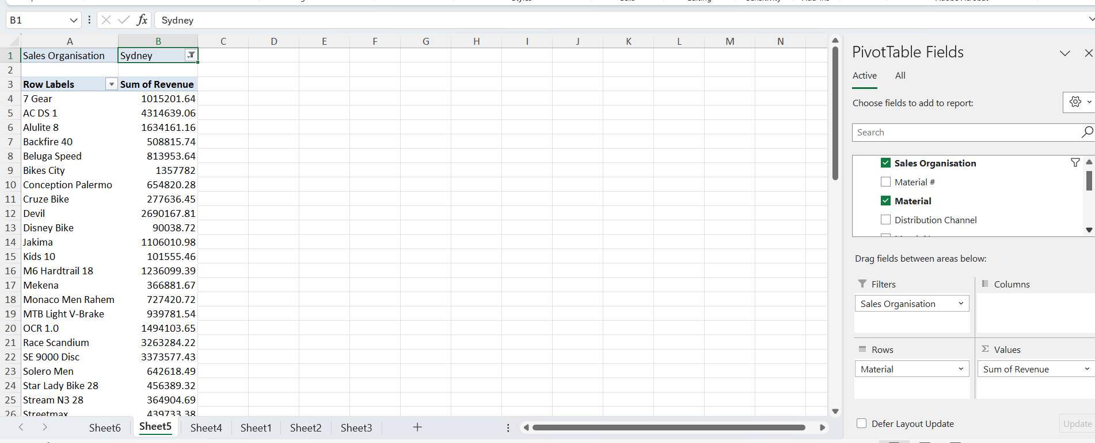
2. Tutorial Week 2: Exercises
a) Which material provided the most revenue in Sydney?
Add "Material" to the Rows area of the PivotTable.
Add "Revenue" to the Values area and set it to sum the revenue.
Add "Sales Organisation" or the field that represents locations to the Filters area and filter for "Sydney."
After setting up, look for the highest revenue number beside a material in the PivotTable.

Slide 35
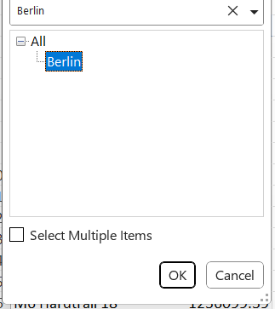
2. Tutorial Week 2: Exercises
b) What is the total sales revenue for Germany?
Remove all filters except for the one that represents locations.
Filter the location to "Germany."
Make sure "Revenue" is in the Values area set to sum up the revenue.

Slide 36
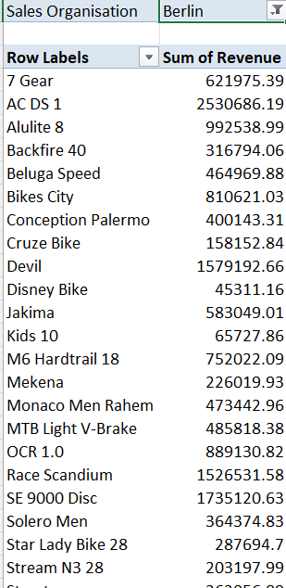
2. Tutorial Week 2: Exercises
b) What is the total sales revenue for Germany?
Remove all filters except for the one that represents locations.
Filter the location to "Germany."
Make sure "Revenue" is in the Values area set to sum up the revenue.

Slide 37
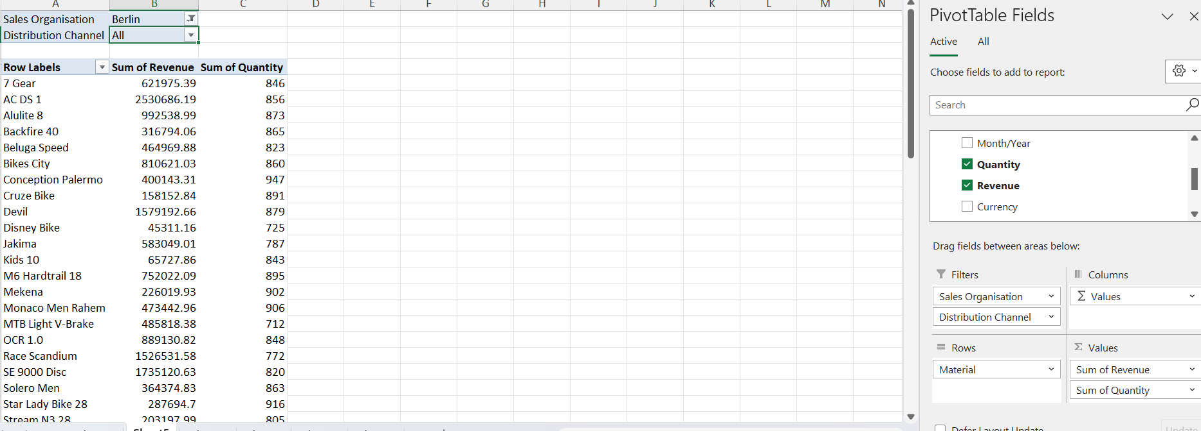
2. Tutorial Week 2: Exercises
c) What is the total wholesale quantity?
Remove the location filter.
Add "Distribution Channel" to the Filters area and select “All."
Add "Quantity" to the Values area and set it to sum the quantity.

Slide 38
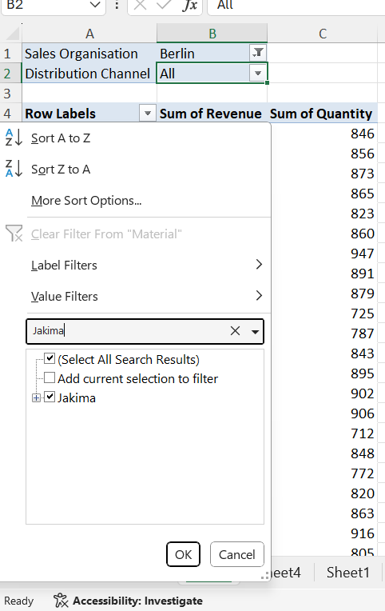
2. Tutorial Week 2: Exercises
d) What percentage of the total sales quantity for Germany is the Jakima material?
Filter the location to "Germany."
Filter the Material to "Jakima."
In the Values area, click on the "Quantity" field, then select "Show Value As" from the context menu, and choose "Percentage of Grand Total."

Slide 39
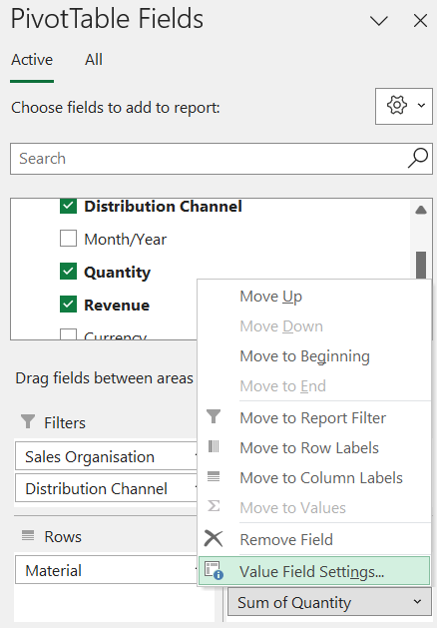
2. Tutorial Week 2: Exercises
d) What percentage of the total sales quantity for Germany is the Jakima material?
Filter the location to "Germany."
Filter the Material to "Jakima."
In the Values area, click on the "Quantity" field, then select "Show Value As" from the context menu, and choose "Percentage of Grand Total."

Slide 40
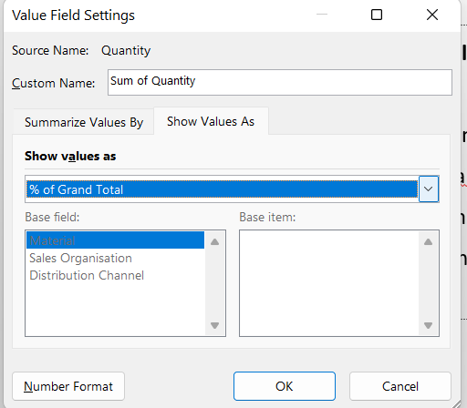
2. Tutorial Week 2: Exercises
d) What percentage of the total sales quantity for Germany is the Jakima material?
Filter the location to "Germany."
Filter the Material to "Jakima."
In the Values area, click on the "Quantity" field, then select "Show Value As" from the context menu, and choose "Percentage of Grand Total."

Slide 41
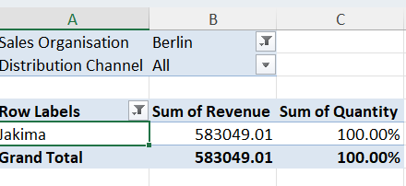
2. Tutorial Week 2: Exercises
d) What percentage of the total sales quantity for Germany is the Jakima material?
Filter the location to "Germany."
Filter the Material to "Jakima."
In the Values area, click on the "Quantity" field, then select "Show Value As" from the context menu, and choose "Percentage of Grand Total."

Slide 42
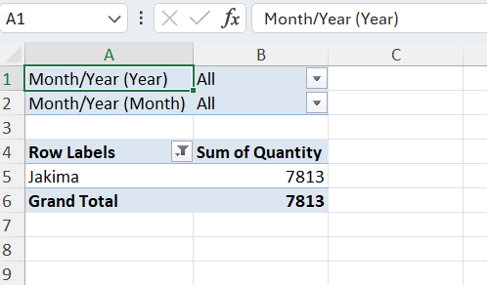
2. Tutorial Week 2: Exercises
e) What is the biggest selling product in terms of quantity in April 2007?
Set up the PivotTable:
Drag the date field to the “Filters” area of the PivotTable.
Drag the material (or product) field to the “Rows” area.
Drag the quantity field to the “Values” area. Ensure that it is set to sum the quantities (it should say "Sum of Quantity").

Slide 43
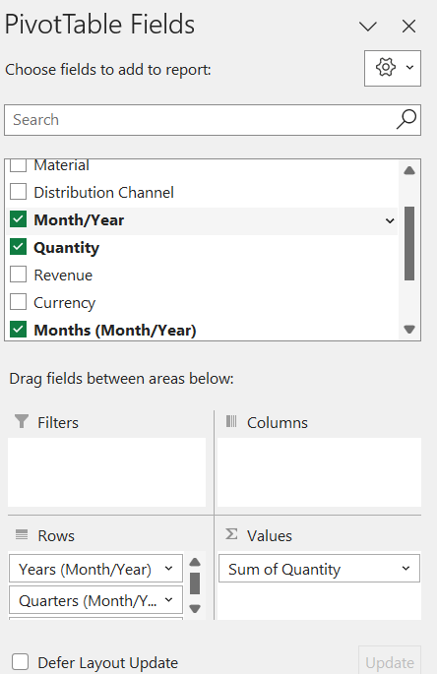
2. Tutorial Week 2: Exercises
e) What is the biggest selling product in terms of quantity in April 2007?
Filter by Date:
Click on the drop-down arrow in the Date filter at the top of the PivotTable.
Choose “Date Filters,” then “Between.”
Enter the start date as 04/01/2007 and the end date as 04/30/2007 to cover all of April 2007.
Click “OK” to apply the filter.
Select the data range that includes the date, material (product), and quantity columns.
Go to the “Insert” tab on the Ribbon and click on “PivotTable.”
In the Create PivotTable dialog box, choose where you want the PivotTable report to be placed (new worksheet or existing worksheet).
Click “OK.”

Slide 44
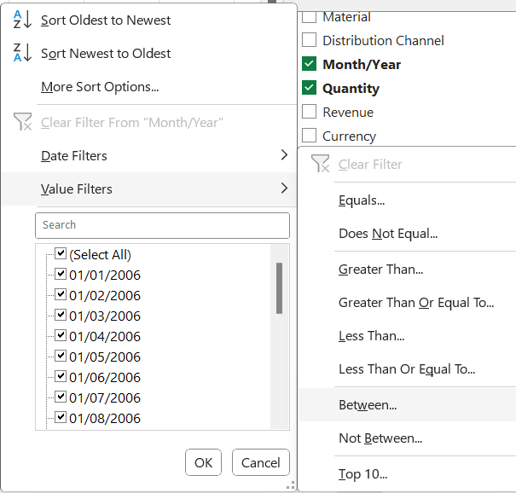
2. Tutorial Week 2: Exercises
e) What is the biggest selling product in terms of quantity in April 2007?
Filter by Date:
Click on the drop-down arrow in the Date filter at the top of the PivotTable.
Choose “Date Filters,” then “Between.”
Enter the start date as 04/01/2007 and the end date as 04/30/2007 to cover all of April 2007.
Click “OK” to apply the filter.
Select the data range that includes the date, material (product), and quantity columns.
Go to the “Insert” tab on the Ribbon and click on “PivotTable.”
In the Create PivotTable dialog box, choose where you want the PivotTable report to be placed (new worksheet or existing worksheet).
Click “OK.”

Slide 45
2. Tutorial Week 2: Exercises
e) What is the biggest selling product in terms of quantity in April 2007?
Filter by Date – Set up PivotTable:
Drag the date field to the “Filters” area of the PivotTable.
Drag the material (or product) field to the “Rows” area.
Drag the quantity field to the “Values” area. Ensure that it is set to sum the quantities (it should say "Sum of Quantity").
Select the data range that includes the date, material (product), and quantity columns.
Go to the “Insert” tab on the Ribbon and click on “PivotTable.”
In the Create PivotTable dialog box, choose where you want the PivotTable report to be placed (new worksheet or existing worksheet).
Click “OK.”

Slide 46
2. Tutorial Week 2: Exercises
e) What is the biggest selling product in terms of quantity in April 2007?
Filter by Date:
Click on the drop-down arrow in the Date filter at the top of the PivotTable.
Choose “Date Filters,” then “Between.”
Enter the start date as 04/01/2007 and the end date as 04/30/2007 to cover all of April 2007.
Click “OK” to apply the filter.
Select the data range that includes the date, material (product), and quantity columns.
Go to the “Insert” tab on the Ribbon and click on “PivotTable.”
In the Create PivotTable dialog box, choose where you want the PivotTable report to be placed (new worksheet or existing worksheet).
Click “OK.”

Slide 47
2. Tutorial Week 2: Exercises
e) What is the biggest selling product in terms of quantity in April 2007?
Identify the Biggest Selling Product:
Look at the PivotTable’s “Row Labels” for material/product and corresponding “Sum of Quantity”.
The material/product with the highest “Sum of Quantity” is your biggest selling product for April 2007.
Select the data range that includes the date, material (product), and quantity columns.
Go to the “Insert” tab on the Ribbon and click on “PivotTable.”
In the Create PivotTable dialog box, choose where you want the PivotTable report to be placed (new worksheet or existing worksheet).
Click “OK.”

Slide 48
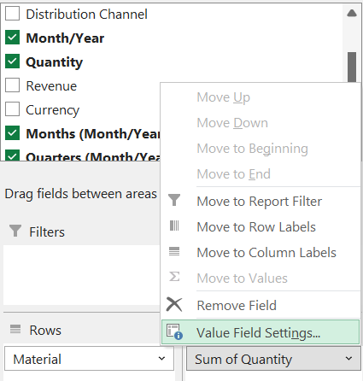
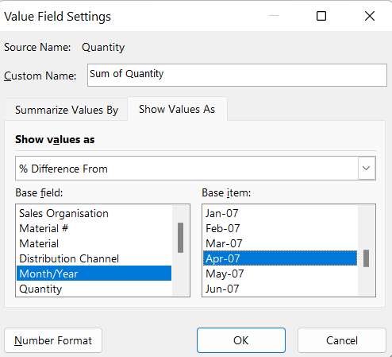
2. Tutorial Week 2: Exercises
f) Which material had the biggest increase in quantity sold from April 2007 to May 2007?
We will need to add "Month/Year" to the Columns or Rows area and "Material" to the other.
Add "Quantity" to the Values area.
Use the "Show Values As" option to calculate the difference from the previous month. This is often found under "Value Field Settings" > "Show Value As" > "Difference From" and then select "Month/Year" and "April 2007" as the base item.

Slide 49
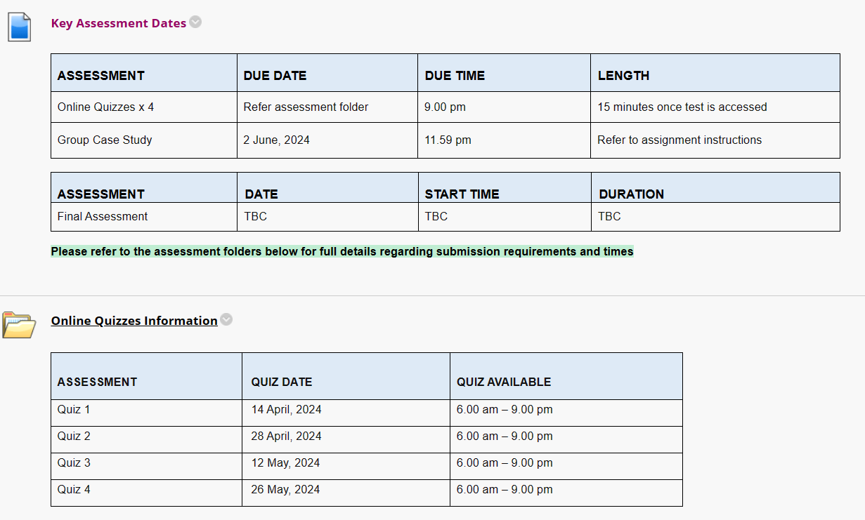
3. Key assessment dates

Slide 50
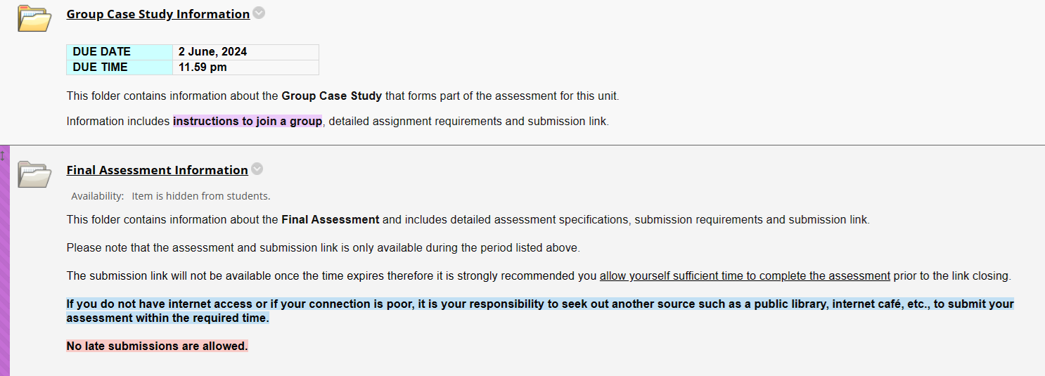
3. Key assessment dates

Slide 51
4. Interactive Questions
Q1) What is the primary function of a PivotTable in Excel?
A) To alter and manipulate the original dataset.
B) To summarize and analyze large datasets without changing the original data.
C) To convert text data into tables.
D) To create complex formulas for data analysis.
Q2) In the context of PivotTables, what does the term 'slice and dice' refer to?
A) Removing all data from a report.
B) Aggregating all data into a single summary.
C) Viewing the data from different dimensions or perspectives.
D) Navigating from detailed to summarized views of data.

Slide 52
4. Interactive Questions
Q3) When setting up a PivotTable to analyze the quantity sold by month/year, where should the "Month/Year" and "Quantity" fields be placed?
A) "Month/Year" in Values and "Quantity" in Rows.
B) Both "Month/Year" and "Quantity" in Filters.
C) "Month/Year" in Columns or Rows and "Quantity" in Values.
D) "Month/Year" in Filters and "Quantity" in Columns.

Slide 53

5. Extra Resources

Slide 54
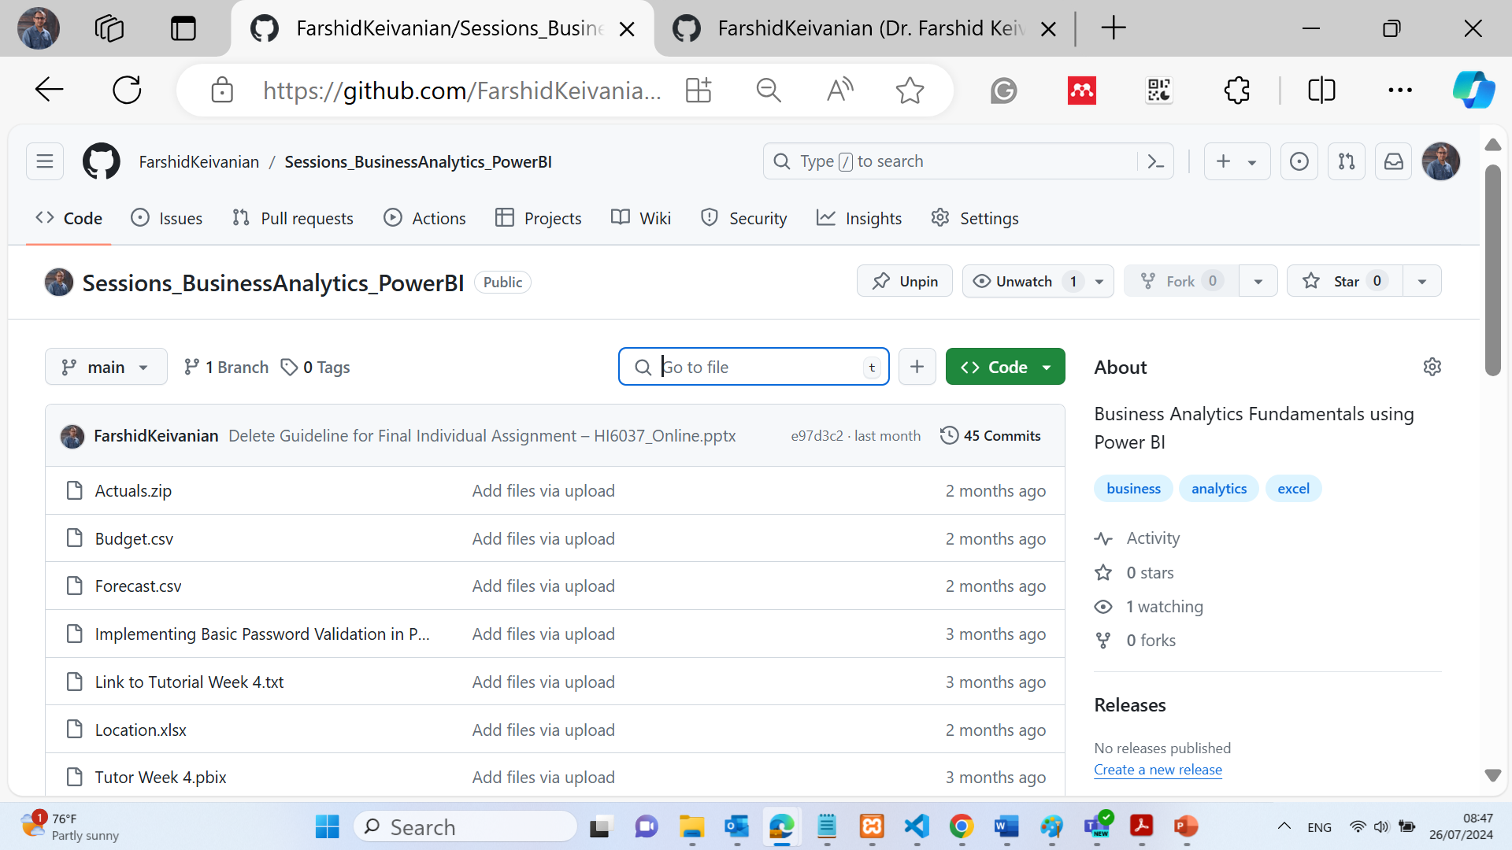
5. Extra Resources

Slide 55

Thank you, Happy Learning! Dr. Farshid Keivanian

